Slide 1
Touch Your Portfolio
Manage contact and message in your portfolio

Slide 2
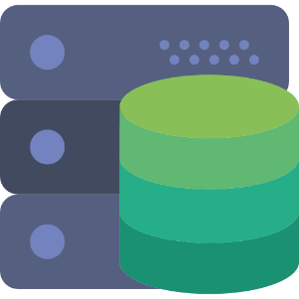

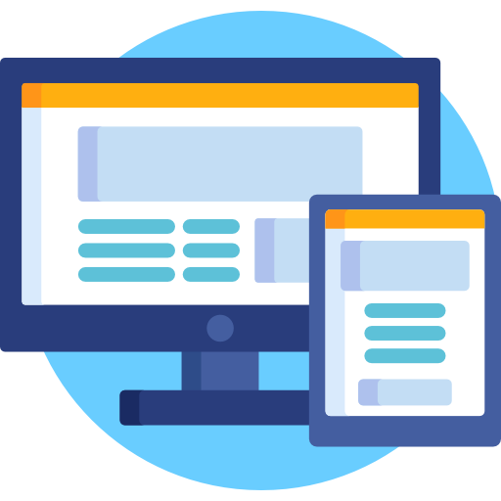
Firebase
Send Message to user from portfolio site
Notification to App

Slide 3
To do this…
Single Page Website
Make a site with Google Auth
Registration for portfolio site
Generate JavaScript snippets for that portfolio site
Make users to download it
Android App
View all the messages
Notification for new messages
Add reply button to each message
Send reply mail through Gmail(using mailto:)

